Slide 1

CLINICAL DECISION SUPPORT SYSTEM by ids team
Under the guidance of
Dr.Urcun Tanik

Slide 2
Ids team details
Project Manager
Amarnath Reddy sagili
Team Details
Avinash Kolachalam
Deepika Duggumpudi
Sravanthi Pinnamareddy
Vandana Malik
Prasanth Polavarapu
Reshma Kota
Neha Singh Thakur
Shravya Beerakayala
Srinivas Myana
Srinath Myana
Waseem Ahmed

Slide 3
INTRODUCTION
The main idea of the project is to analyze how the Clinical Decision Support System is used in the design analysis of the medical devices and technology offered for better treatments in the world. We have done a lot of research and put forward some examples of CDSS in usage and their results.

Slide 4
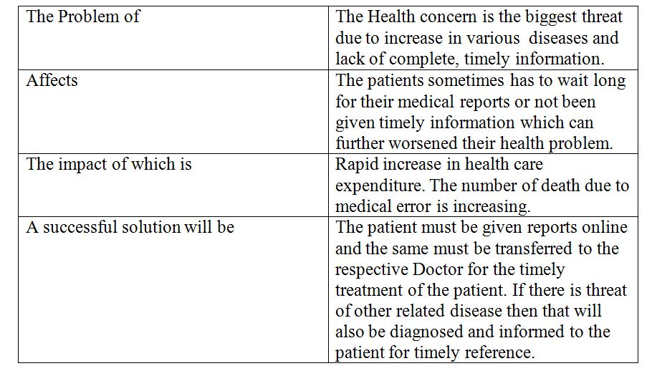
vision template
Part 1 :Problem Statement

Slide 5
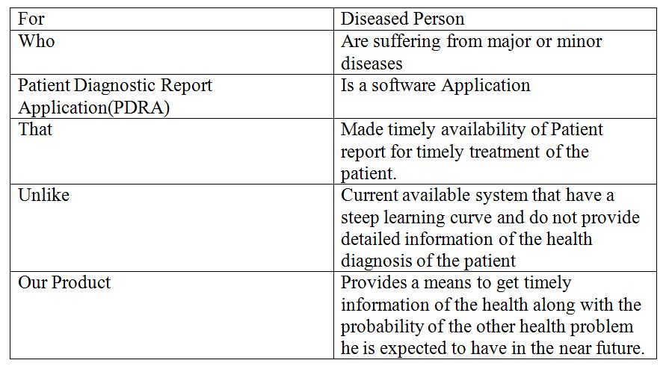
Part 2 : Product Position Statement

Slide 6
PROJECT MANAGEMENT PLAN
Software Project Management Plan is the controlling document for managing a software project; it deﬁnes the technical and managerial processes necessary to develop software work products that satisfy the product requirements.
Project Organization is the clause of the SPMP, it identifies interfaces to organizational entities external to the project; describe the project’s internal organizational structure; and define roles and responsibilities for the project.

Slide 7
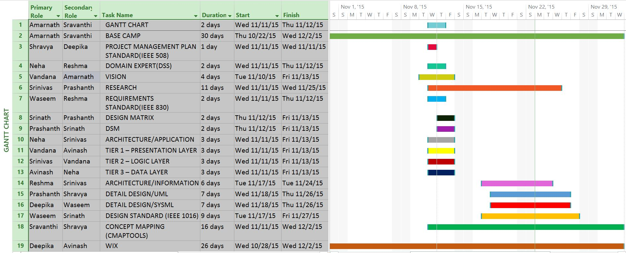
GANTT CHART

Slide 8
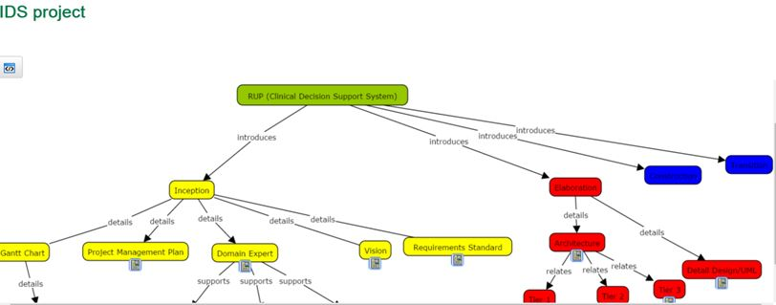
Concept MAP tool
https://cmapscloud.ihmc.us/viewer/cmap/1PLX6FYMB-1G3X3PQ-8J

Slide 9
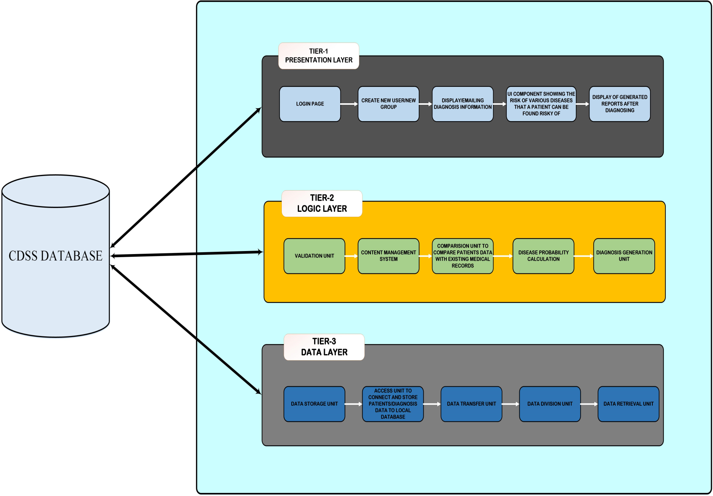
ARCHITECTURE

Slide 10
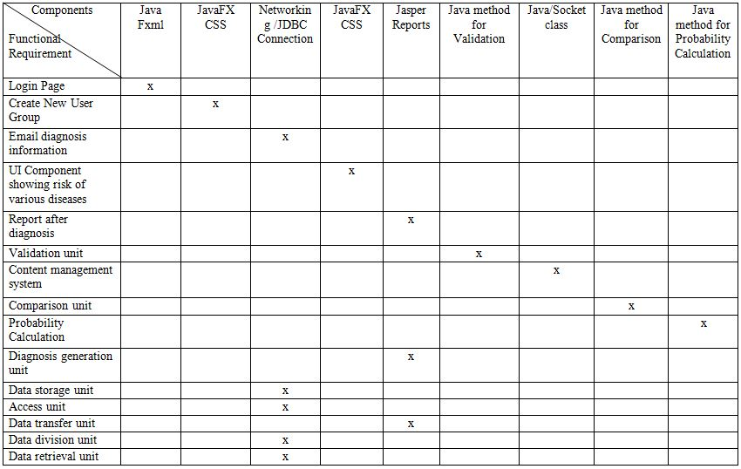
DESIGN MATRIX

Slide 11
conclusion
The project deals with one step ahead of the diagnostic assessment, that is, PDRA (Project Diagnostic Report Application) which provides valuable information to the patients about their diagnosis and the risk or probability for other disease associated with it.

Slide 12


